Slide 1
Eduroam Stats
By: Tong Zi Hang (SingAren Intern)

Slide 2
Architecture of stats program
Convert.py: Processes log file data into text and csv files
IHL.py: Contains methods for uniqueUserFiles I/O and variables for log data extraction.
CreateHTML.py: Writes html files for each IHL.
CreateHTML_singaren.py: Writes html file for singaren staff.
Ihlconfig.json: Contains server names and Ip addresses.
Daily/Monthly/Yearly/ServerLoad CSV files: Contains extracted data for displaying on stats webpage

Slide 3
Differences from previous version
No dependency on Google API.
Data now saved in internal CSV files, not in Google Sheets.
Improved code maintainability
Adding of IHL only requires IHL details (server names and ip addresses) in ihlconfig.json file.
Added new webpage total.html:
Shows accepted/rejected requests from all ihls for singAren staff to check load on eduroam server.
Hourly/Daily/Monthly intervals

Slide 4
Definitions
Daily/Monthly/Yearly charts reflect unique users for each IHL.
LocalUsers: Users at IHL A accessing eduroam overseas or at other IHLs.
Visitors: Foreign exchange users accessing eduroam at IHL A.
Rejected: Includes all rejected users(local/visitors) for IHL A

Slide 5
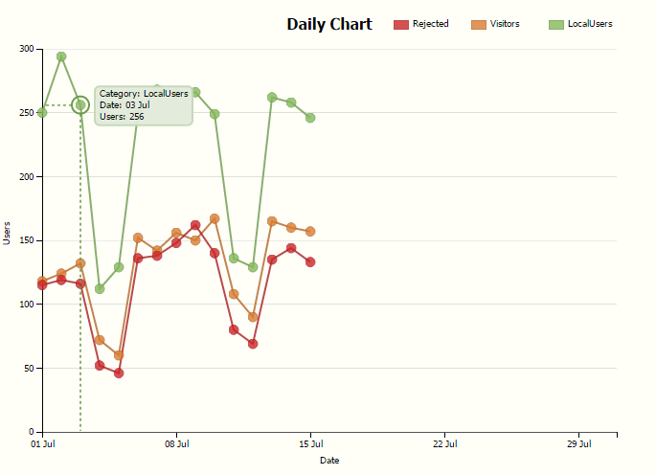
Daily Chart
Features:
Details on mouseover
Unique users for each day
Dotted lines to highlight position on graph

Slide 6
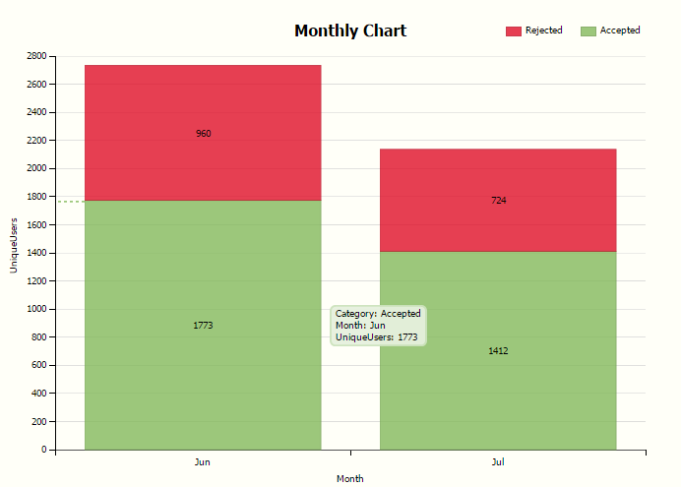
Monthly Chart

Slide 7
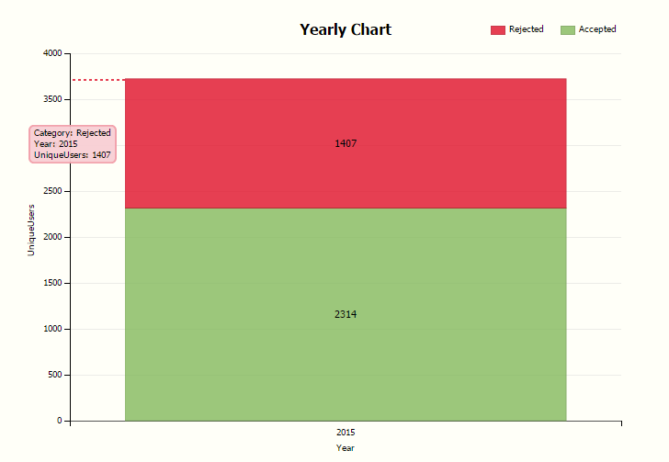
Yearly Chart

